Slide 1
Clocks and Watches Figures

Slide 2
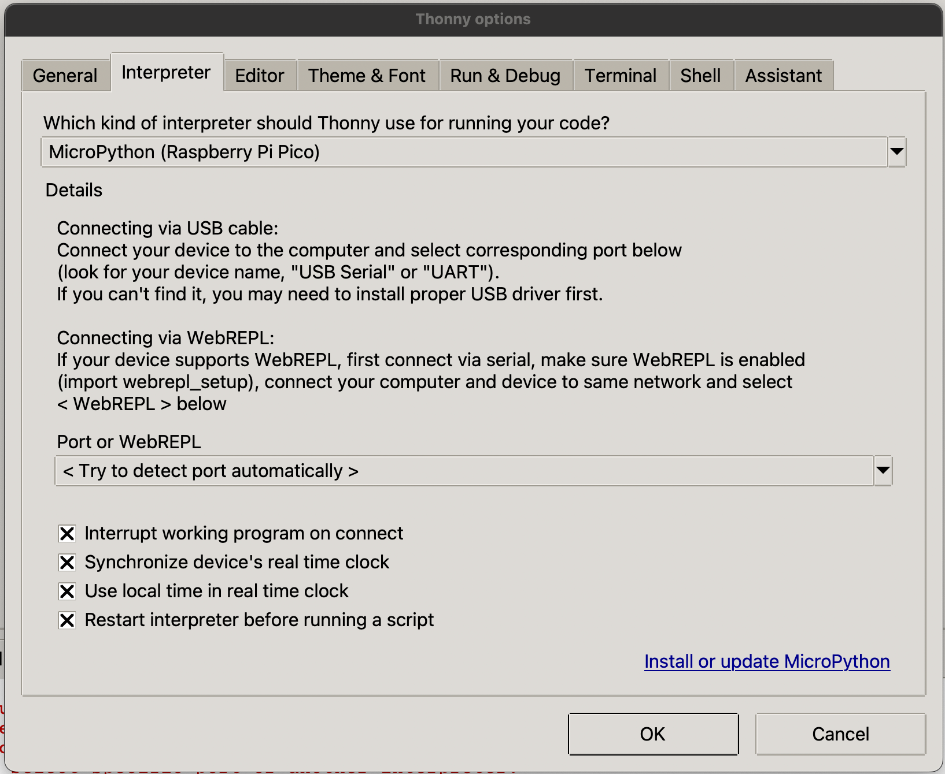

Slide 3
The intersection of timekeeping, art, and computational thinking
Timekeeping
Art
This Book
Computational
Thinking

Slide 4
Architecture of a Microcontroller Clock
Display
(OLED)
Sensors
(buttons)
Microcontroller
(RP2040)
Communications
Bus
Power

Slide 5
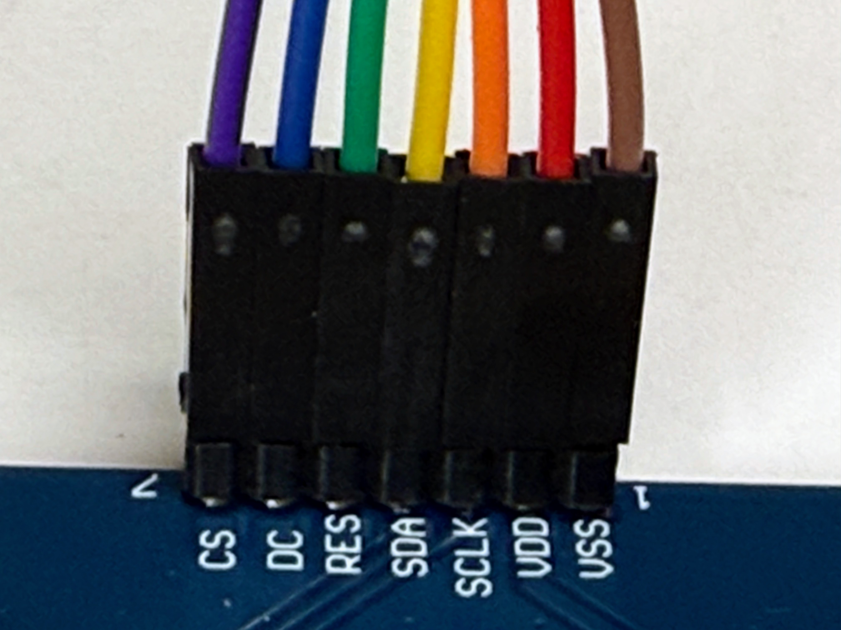
Display Cable Pins
GND is Black or Brown
3.3 V Power
GND

Slide 6
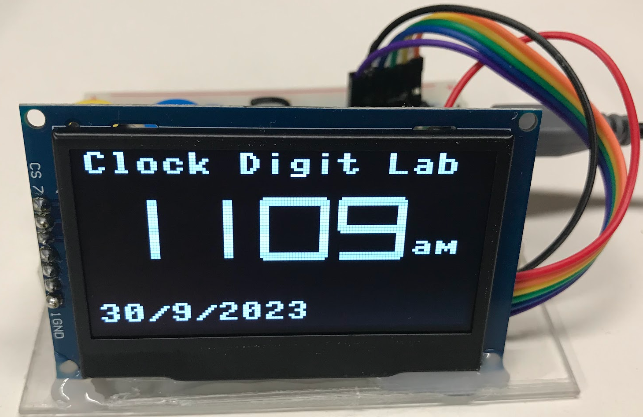
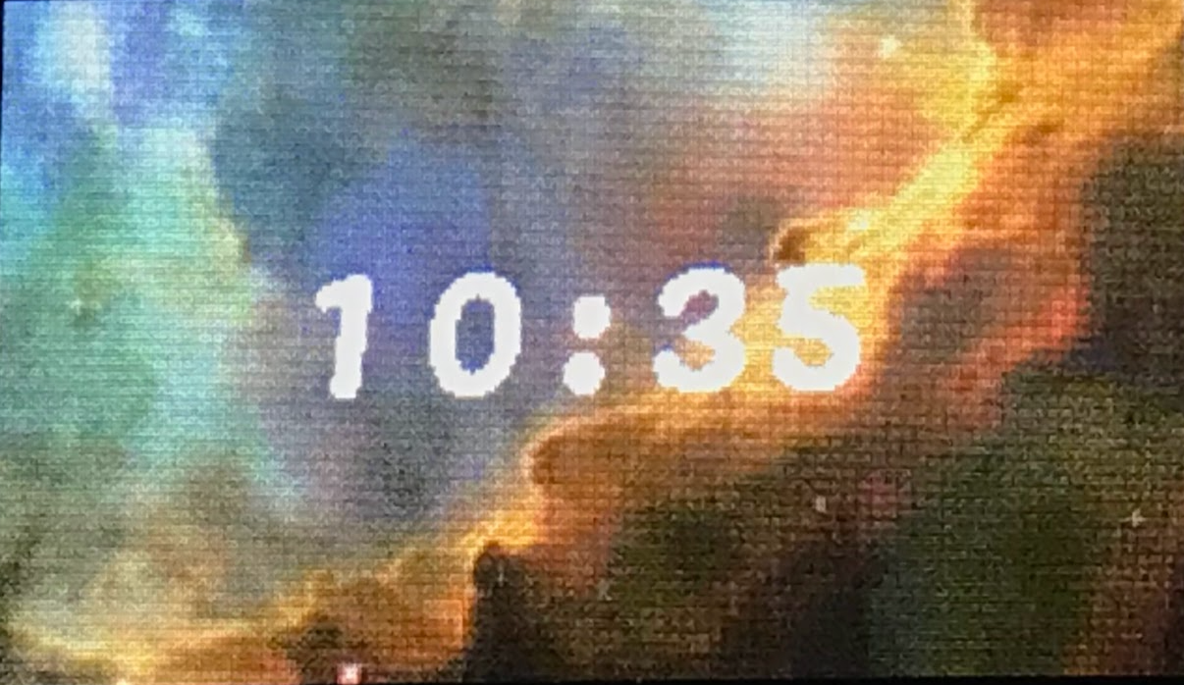
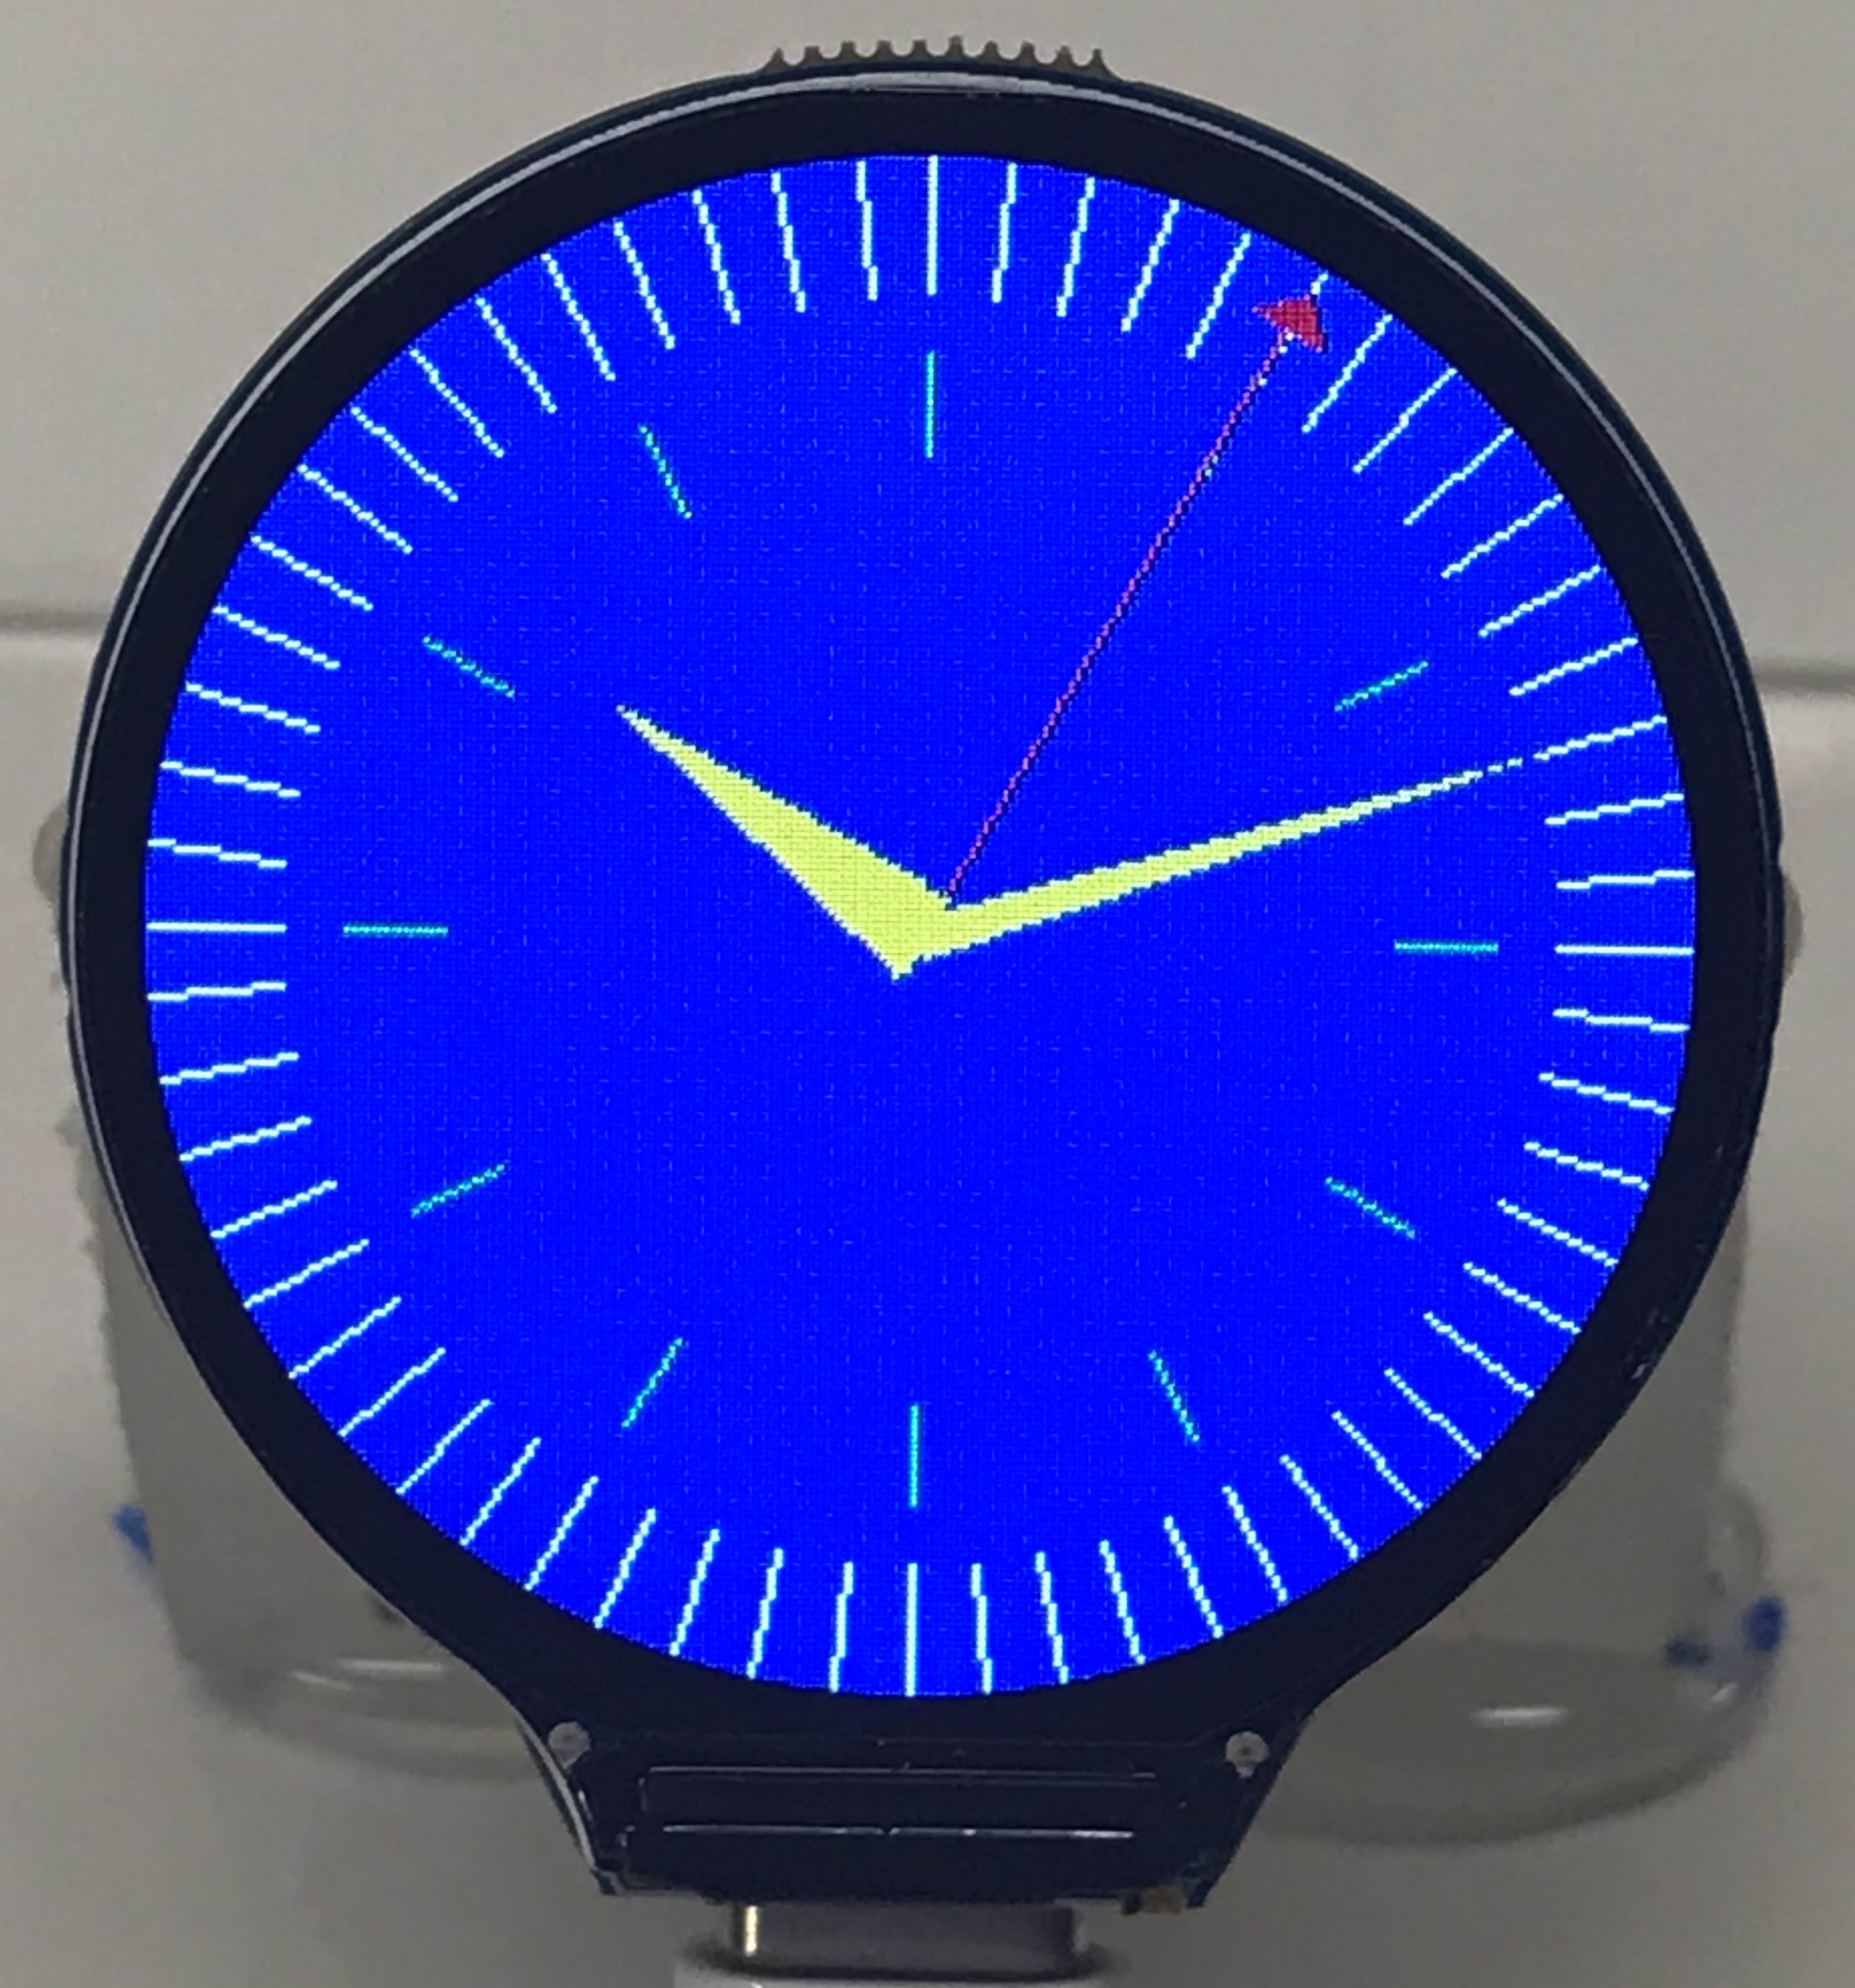
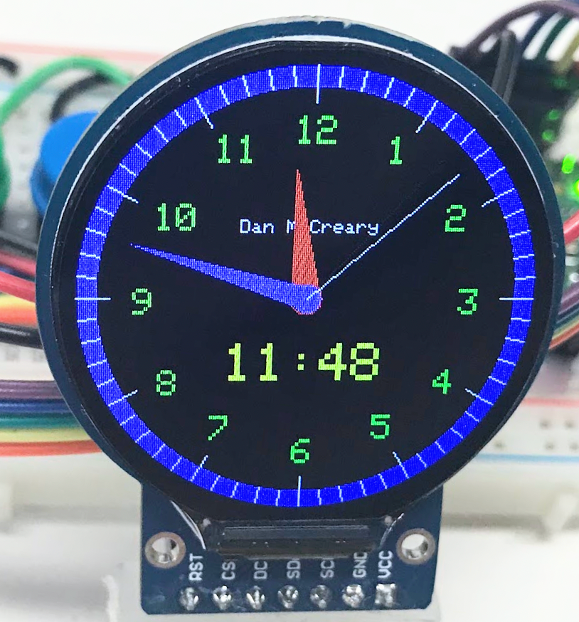
Banner
banner

Slide 7
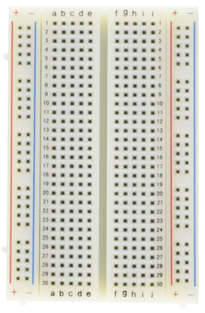
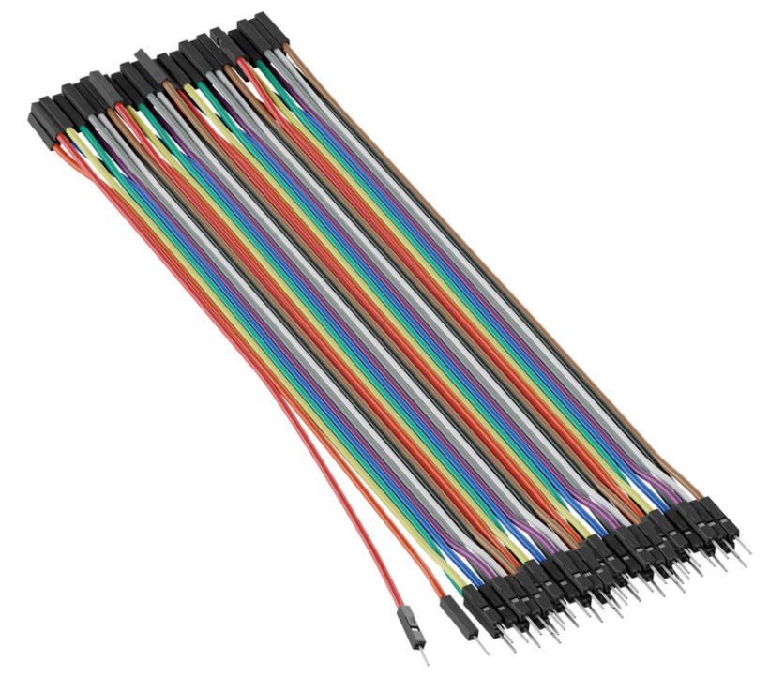
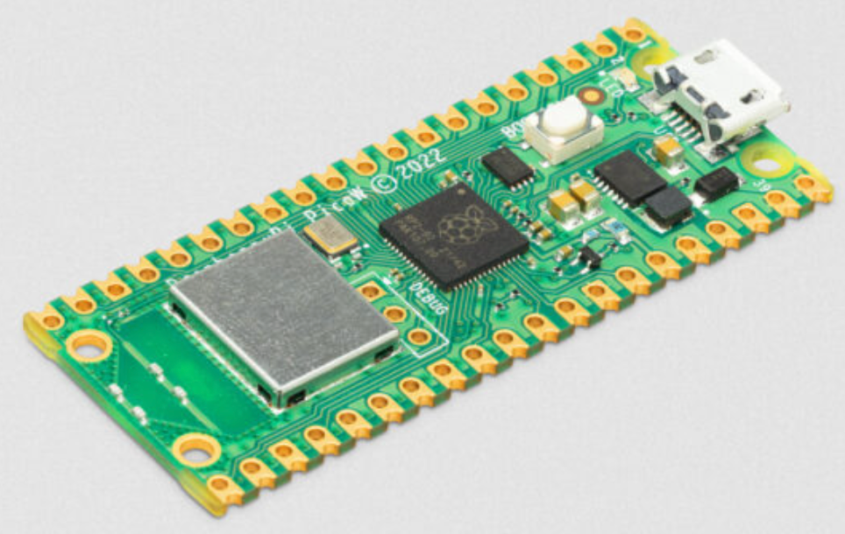
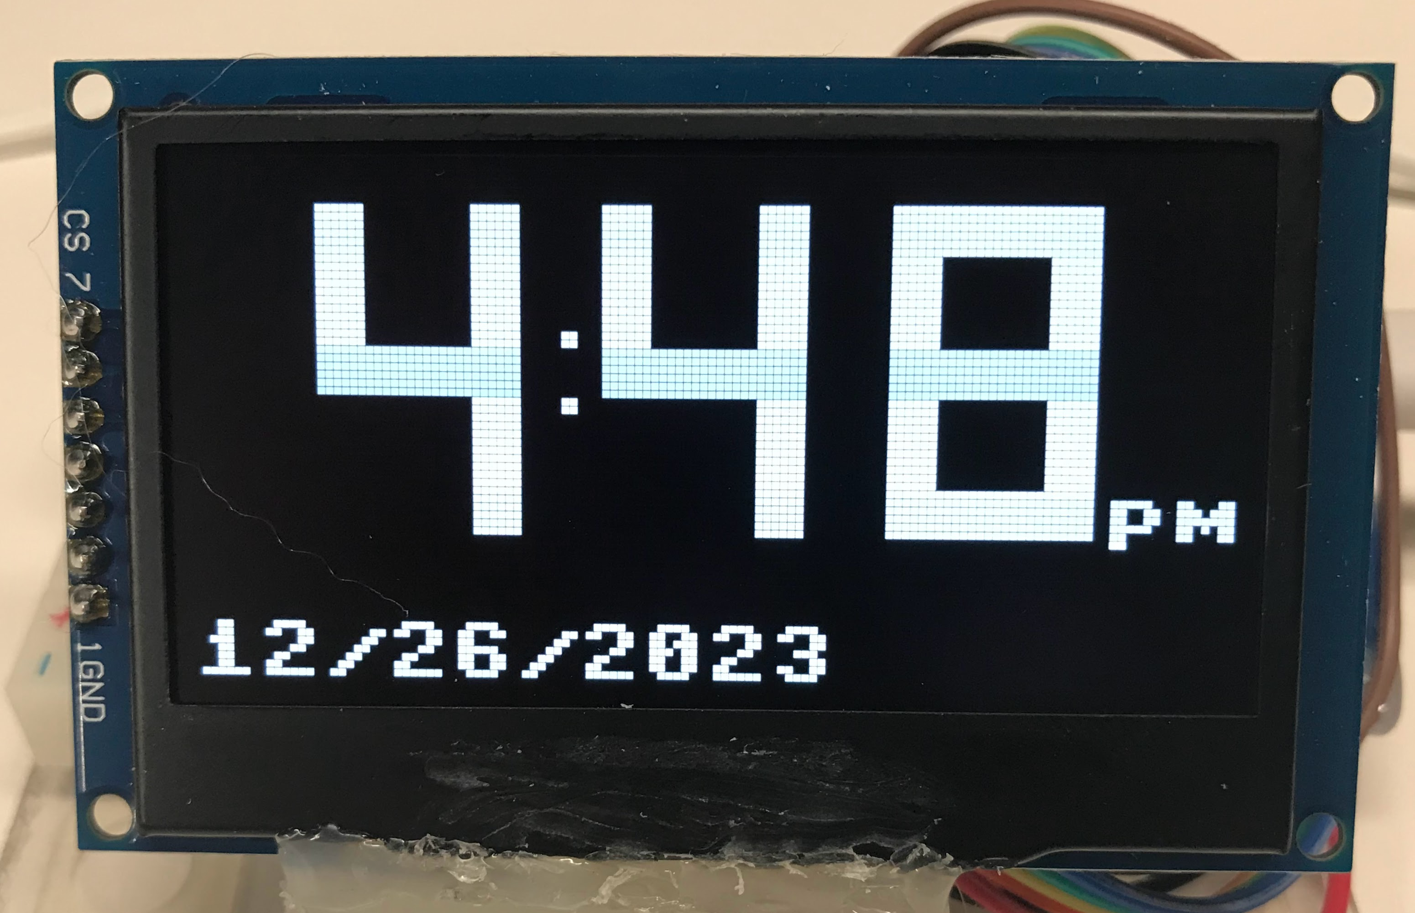
Minimal Parts
Breadboard Half-size 400 Tie
20 cm M-F
Jumpers
2.42” OLED Display
Raspberry Pi Pico

Slide 8
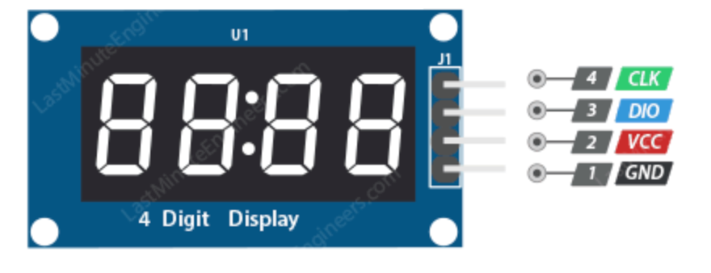

Slide 9
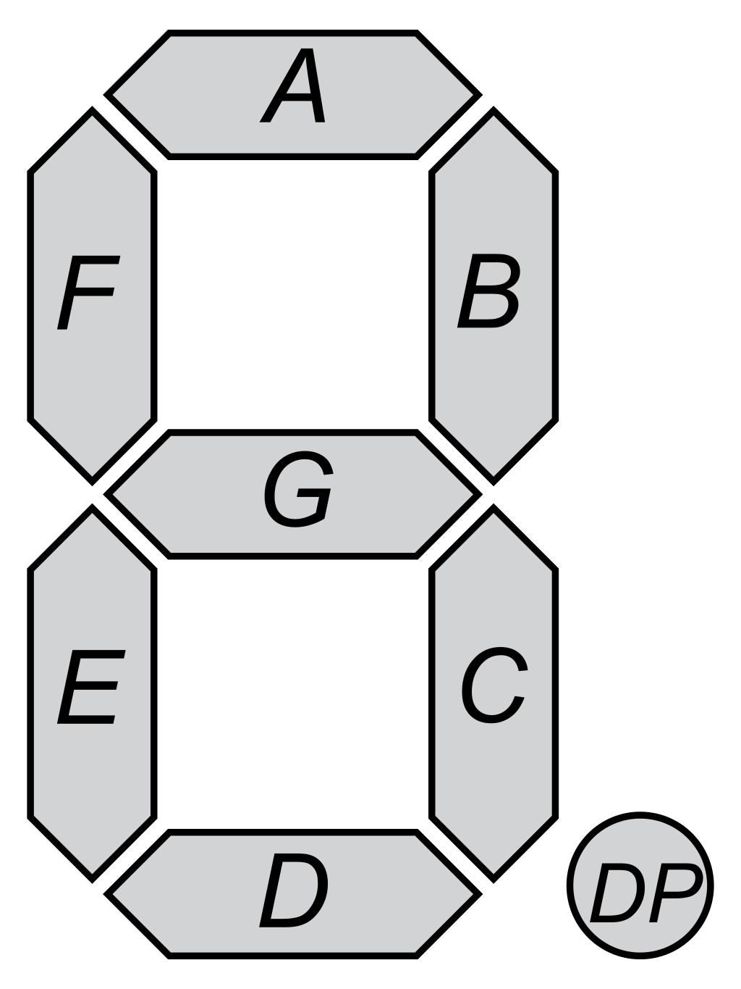
5
0
1
6
4
2
3

Slide 10
5
0
1
5
0
1
6
6
4
2
4
2
3
3

Slide 11
(X,Y)
0
(X,Y – (height//2)-(thickness //2)
6
(X,Y-thickness)
3

Slide 12
(X,Y)
(X - thickness, Y)
5
0
1
(X, Y + height//2)
6
(X + width - thickness, Y + height//2)
4
2
3

Slide 14
Digital Clock Display
x1
x3
x3
x3
y2
x2
x4
x5
x8
y1
y3
x9
x7
am
x6
y4

